Slide 1
What We Know About
Google’s New
Link Evaluation
Mechanism

Slide 2
Mohammad Amin Ghalebi
Senior SEO Specialist @ Digikala Group

Slide 3
What We Discuss:
Importance of Links
1
2
Old PageRank
Updated PageRank Patent
3
4
Penguin Algorithm
Reduced Link Graphs
5
6
Use Cases

Slide 4
Why Links Are Important?
1
Helps to Navigate Throught the Web
2
Helps Search Engines Discover New Pages
3
Can Determine How Well a Page Should Rank

Slide 5
Five Years of Google Ranking Signals
Bill Slawski
Director of
SEO Research
@Go Fish Digital

Slide 6
What is PageRank?
PageRank (PR) is a mathematical formula that judges the “value of a page” by looking at the quantity and quality of other pages that link to it.
Its purpose is to determine the relative importance of a given webpage in a network (i.e., the World Wide Web).

Slide 7
What Factors Were Used to Calculate PageRank?
The quantity and quality of inbound linking pages
1
The number of outbound links on each linking page
2
The PageRank of each linking page
3

Slide 8
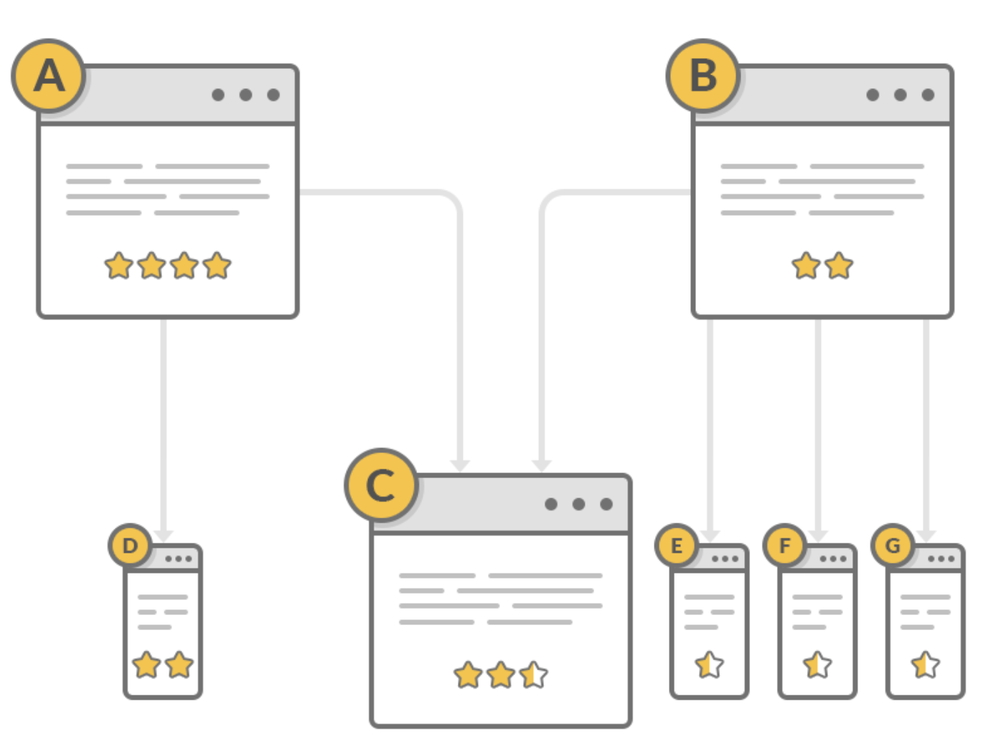
Example :
Formula: PR(A) = (1-d) + d (PR(T1)/C(T1) + ... + PR(Tn)/C(Tn))
Page C PageRank: PR(C) = (1-0.85) + 0.85 (PR(A)/2) + (PR(A)/4) )

Slide 9
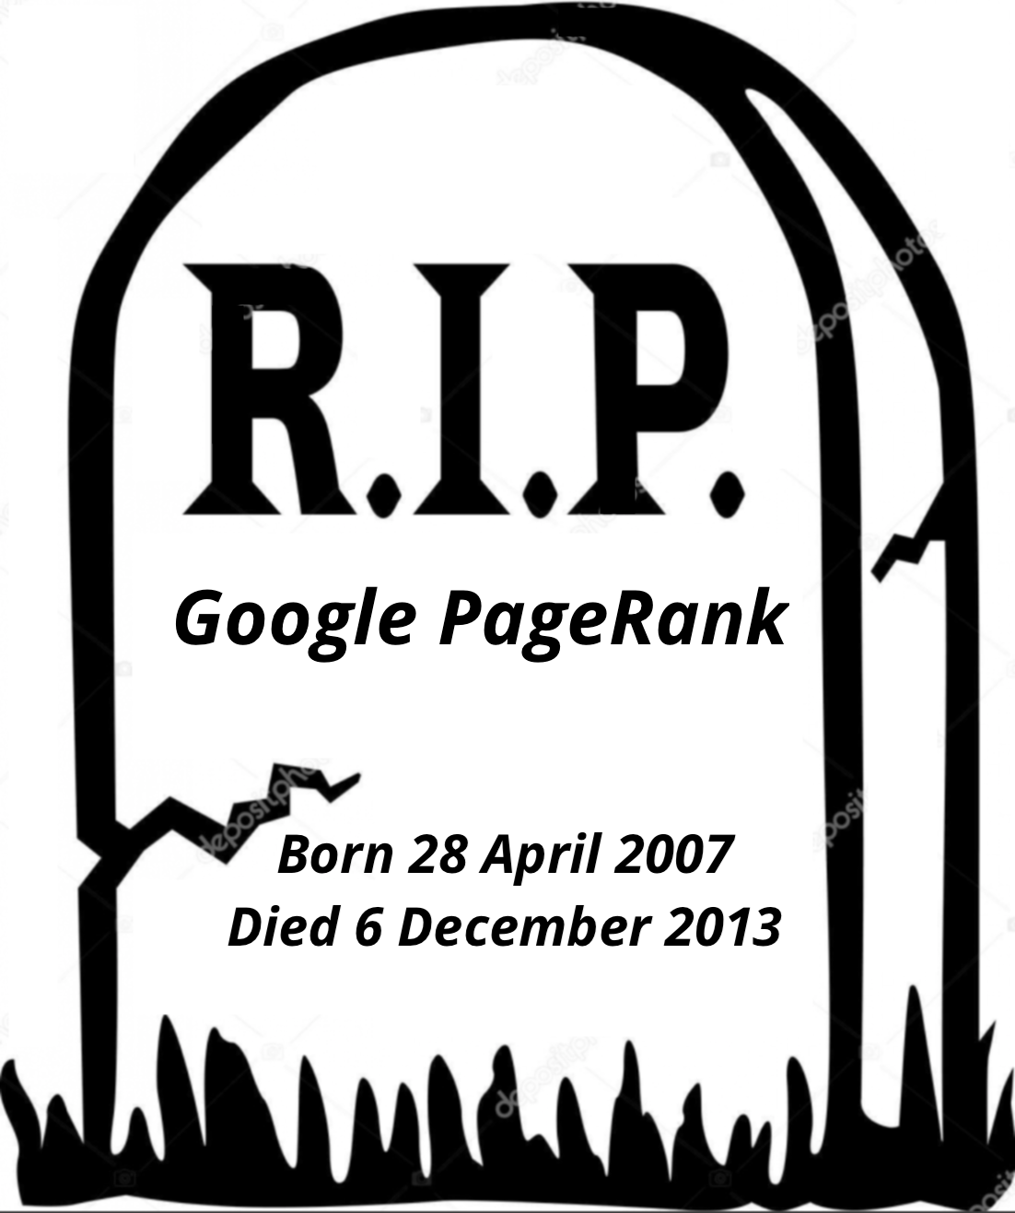
PageRank Died !!
The last official Google PageRank update was on
December 2013
PageRank on toolbars went to 0
But …
Is PageRank Dead Really ??

Slide 10
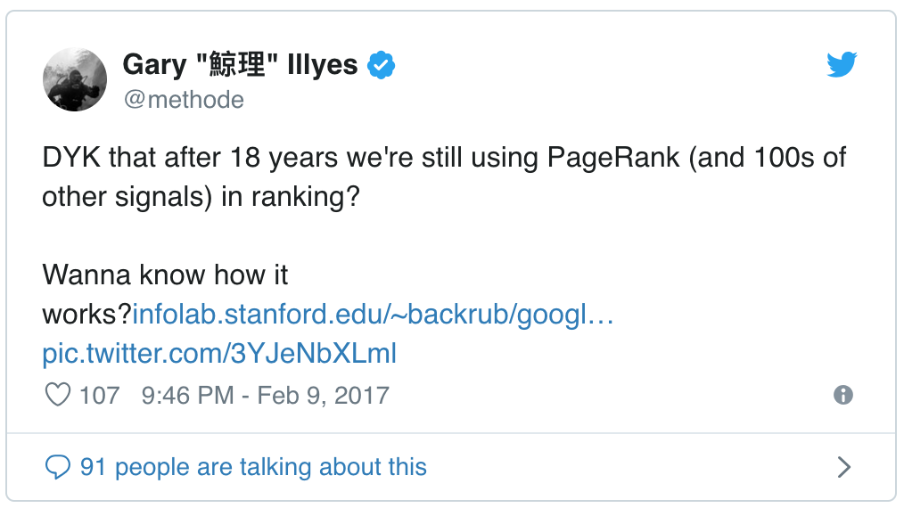
The Dark Night Rises in Silence !!
Garry Illyes
Former Google Webmaster Trend Analyst

Slide 11
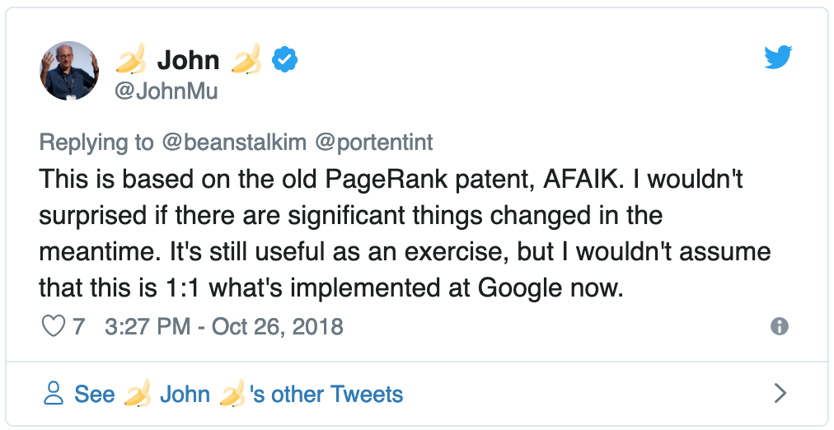
John Muller
Senior Google Webmaster Trend Analyst

Slide 12
Google PageRank Patent Updated !!
The original PageRank patent updated in April 24, 2018

Slide 13
Why This Updated Patent is Important?
1
Google spend lots of time and money for researching and creating patent
2
It is a Continuation Patent!
3
Google wants to protect the process legally

Slide 14
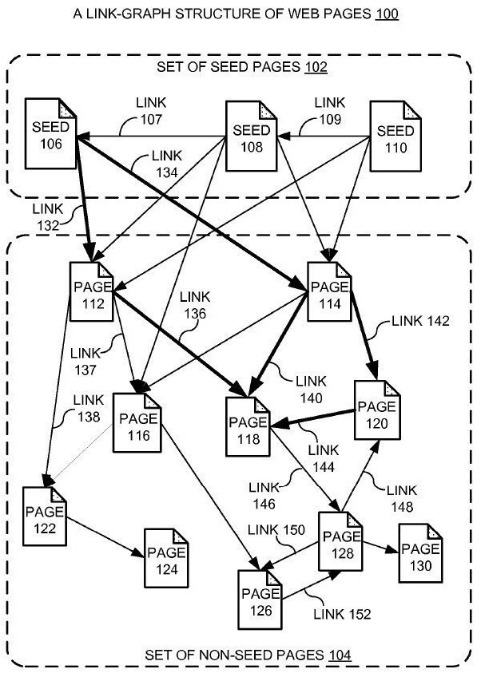
How This One Works?
Producing a ranking for pages using distances in a web-link graph
It calculate distances between an authorative and spam free site & the sites it linked to
The seed sites are divided by topic and are different for every nich.

Slide 15
Simple Example :
Website.com
Category B
Category C
Sub
A
SubB
3
4
1
2
Distance (Hops) from Homepage:
Category B 1 hop
Sub Category A 2 hops
Product 2 3 hops
Product 3 2 hops
Category
Sub Category
Product

Slide 16
Web link-graph Example :
Seed
Seed
Seed
Seed

Slide 17
Why this algorithm is so good?
The updated PageRank allows sites in small niche topics to be able to outrank larger sites that have more links !!
There aren’t many sites linking in a small niche to build up large amounts of PageRank.
This gives smaller sites in smaller niches a boost in rankings.

Slide 18
What are the “Trusted” sites?
This algorithm is about creating a map of links between web pages.
The starting point for this map of the web is what Google determines is the most authoritative and spam free sites.

Slide 19
Seed sites are Diversified
The patent states that the seed set must be diverse.
It means choosing seed sites across a range of topical niches
Pros:
Can shorten the paths from the seeds to a given page.
Cons:
If it does not have a limit, makes the algorithm open to spamming.

Slide 20
Is This a Topical Trust Rank Algorithm?
Google’s Patent Does Not Use
the Word “Trust”
It just starting from trusted pages to calculate distances between the seed set and the pages they link to
It ranks according to distance

Slide 21
What is Penguin Algorithm?
It is an algorithm which filters spammy pages to show in SERP results.

Slide 22
What Penguin is… NOT?
Is Penguin a Trust Algorithm?
No, Penguin is not a Trust Algorithm.
Penguin is also not a Topical Trust Algorithm!

Slide 23
Does Penguin Use Machine Learning?

Slide 24
Garry Illyes said in 2016

Slide 25
Does Penguin Use Statistical Analysis?
Percentage of inbound links that contain an anchor text
23.5%
30.1%
Ratio of inlinks to home page versus inner pages
Ratio of outlinks to inlinks
12.1%
29.6%
Ratio of money keywords to brand and non beneficial keywords
Ratio of links in body versus widget links
9.8%

Slide 26
Does it ??

Slide 27
Reduced Link Graph
Are all links important to measure in link analysis?
Which links should be used in web link analysis?
“Reduced link graphs are a way that search engines can identify high quality websites and remove low quality spam sites from the link ranking calculation.
The purpose of Reduced Link Graphs are to find qualified links.”

Slide 28
Why Reduced Link Graph is Important?
It matches with what we know about Penguin.
IN
OUT
X
With the Penguin algorithm, you are either in the game or you are out of the game and have no chance of ranking.
If your link profile excludes you from the reduced link graph, you will never ever rank for your phrases.

Slide 29
Google Algorithms:
Penguin
Reduced Link Graph
Core Algorithm
PageRank

Slide 30
Use Cases:
No Need to be The Beast !!
You no longer need to have the biggest and highest authority link profile.
identifying the links that are the shortest distance from the most authoritative sites about the topic you want to rank for.

Slide 31
Review your link ratios and Statistical Analysis:
Ratios of links to homepage versus inner pages
Money anchor texts to regular ones
Ratios of link types you get (html, image, pdf, …)
Percentage of inbound links that contain an anchor text
Ratio of outlinks to inlinks
Ratios of links from low quality sites to high quality ones
Follow to Nofollow link Ratio
Link location …

Slide 32
Please don’t link to Spammy sites !
Quality Sites don’t link to spammy sites!
Sites that primarily have inbound and outbound link relationships with pages outside of the reduced link graph will never get inside and consequently will be shut out of the top ten ranking positions.
The statement in title doesn’t also mean that you should not link to anyone!

Slide 33
If you are spamming:
Linking to high quality sites, edu or gov sites won’t save you.
Prepare yourself to be out !!

Slide 34
Disavow’s maybe important for smaller sites:
Disavow’s are less important for big sites for penguin, but maybe important for sites with less links that have lots of spammy or suspicious links.
Other than penguin, in general, it’s better to have a good disavow file uploaded.
Disavow’s are tricky!!!
Do it only if you are a pro . . . (Don’t touch it if you don’t know what you are doing)
Or get help from a Real pro

Slide 35
Dive Deep to Your Outlinks:
Focus on :
Who you are linking to,
How you are linking to,
Why you are linking to

Slide 36
Sources:
http://www.seobythesea.com/2018/06/google-ranking-signals/
http://patft.uspto.gov/netacgi/nph-Parser?Sect1=PTO1&Sect2=HITOFF&d=PALL&p=1&u=%2Fnetahtml%2FPTO%2Fsrchnum.htm&r=1&f=G&l=50&s1=9,953,049.PN.&OS=PN/9,953,049&RS=PN/9,953,049
https://patents.justia.com/patent/9400849
http://www.vldb.org/conf/2004/RS15P3.PDF
http://citeseerx.ist.psu.edu/viewdoc/download?doi=10.1.1.69.1282&rep=rep1&type=pdf
https://www.youtube.com/watch?v=p8mUXQzwEvs

Slide 37
Sources:
http://airweb.cse.lehigh.edu/2007/papers/paper_125.pdf
http://infolab.stanford.edu/~zoltan/publications/gyongyi2005link.pdf
http://ilpubs.stanford.edu:8090/646/1/2004-25.pdf
https://patents.google.com/patent/US9165040
https://patents.google.com/patent/US8082246
http://airweb.cse.lehigh.edu/2007/papers/paper_103.pdf
https://www.youtube.com/watch?v=ALzSUeekQ2Q
https://twitter.com/methode/status/785621866035548160

Slide 38
Thank You

