Slide 1





in an unhappy mood
SEO
Everything about organic traffic loss in different situations
by Shayan Davoodi
SEO at:
Namasha Bamilo Shab Bama

Slide 2
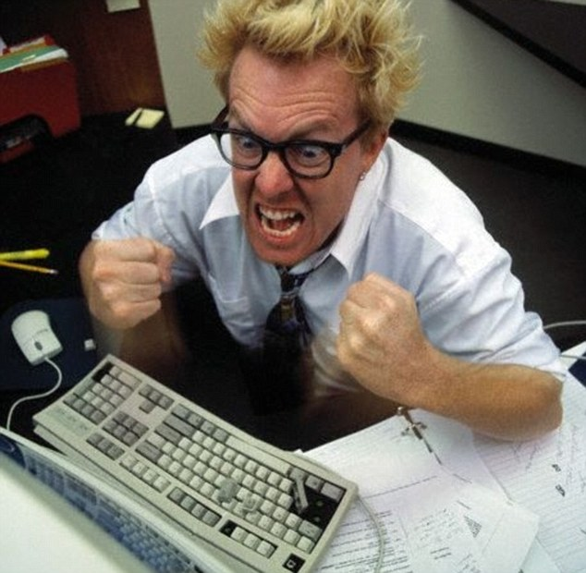
When are we, the SEOs, stressed?
  All the times
  Competitors' evil actions
  Competitors doing better
  Specially in ranking fluctuations,
  WHY?
  Consequences
  Afraid to be questioned
  Unhappy and depressed
  Creativity and performance

Slide 3
Some of possible traffic drop reasons
  Trendy drop/leap
  ?
  ?
  ?

Slide 4

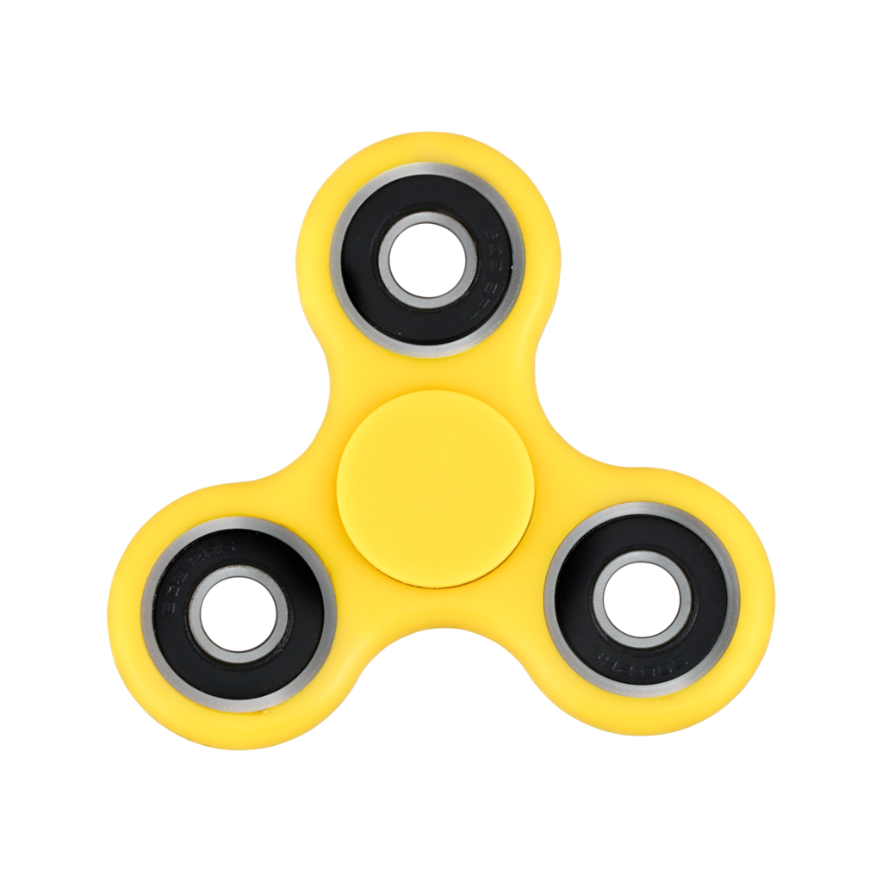
Organic traffic drop/leap due to trends
  Seasonal drop/leaps
  New year
  Black Friday
  Yalda night
  Trendy/event-based drop/leaps
  Someone important dies
  A disease is discussed on TV
  Something becomes fashionable.

Slide 5
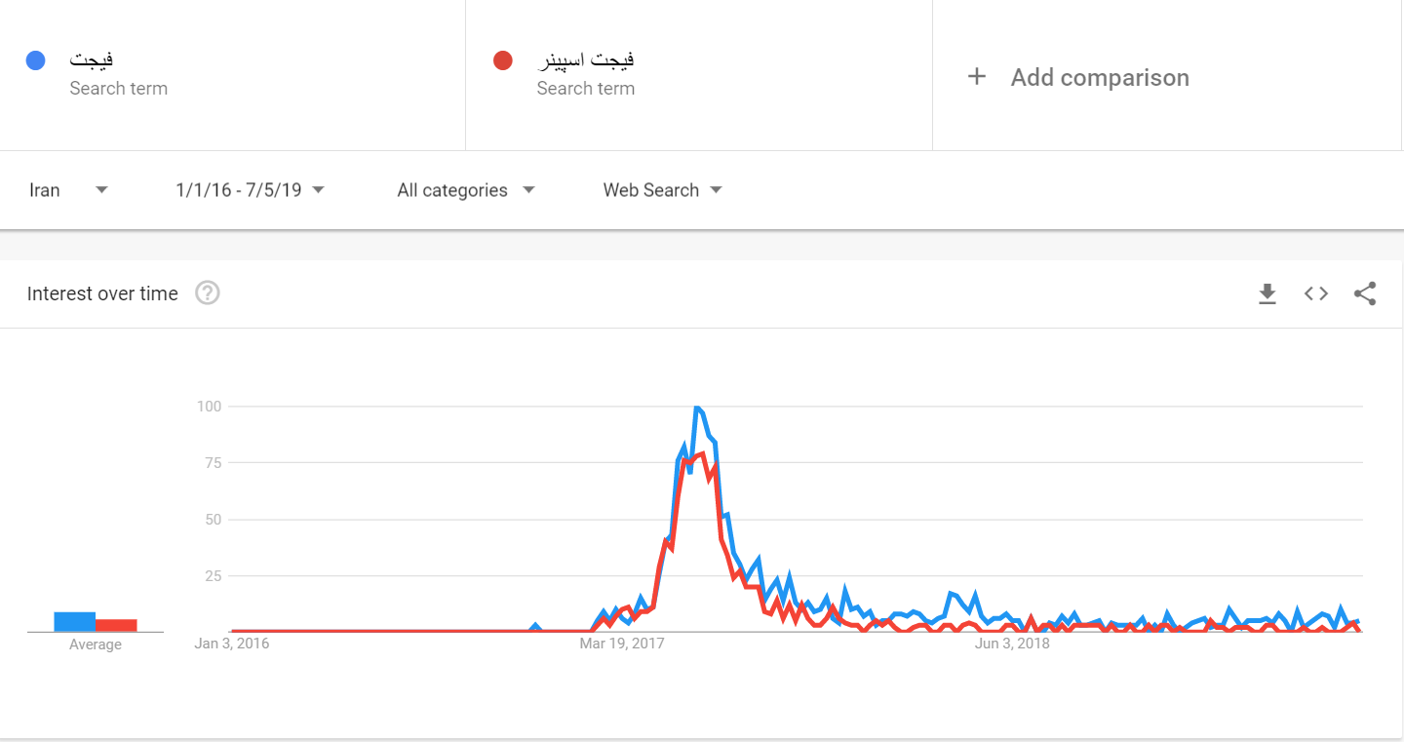
Organic traffic drop due to trends

Slide 6

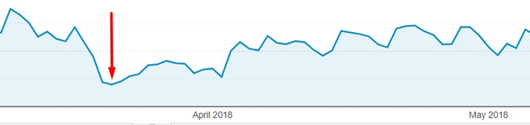
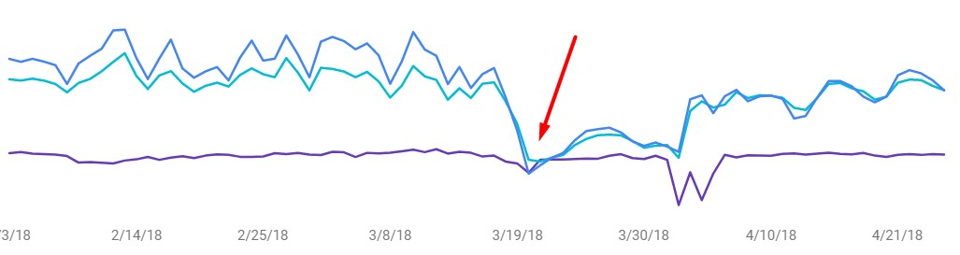
Example: Nowruz
Instruction
  How to figure out?
  Impressions are dropped
  Clicks are dropped
  Avg. position remains the same
  Avg. position for the most of kws.
  remain the same

Slide 7
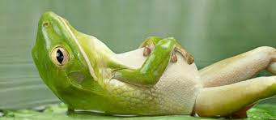
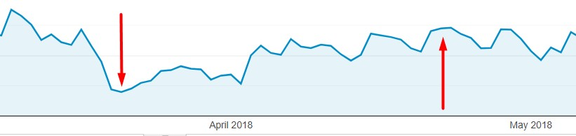
How to deal with it?
  Sit back and relax

Slide 8
Some of possible traffic drop reasons
  Trendy drop/leap
  Algorithm change
  ?
  ?

Slide 9
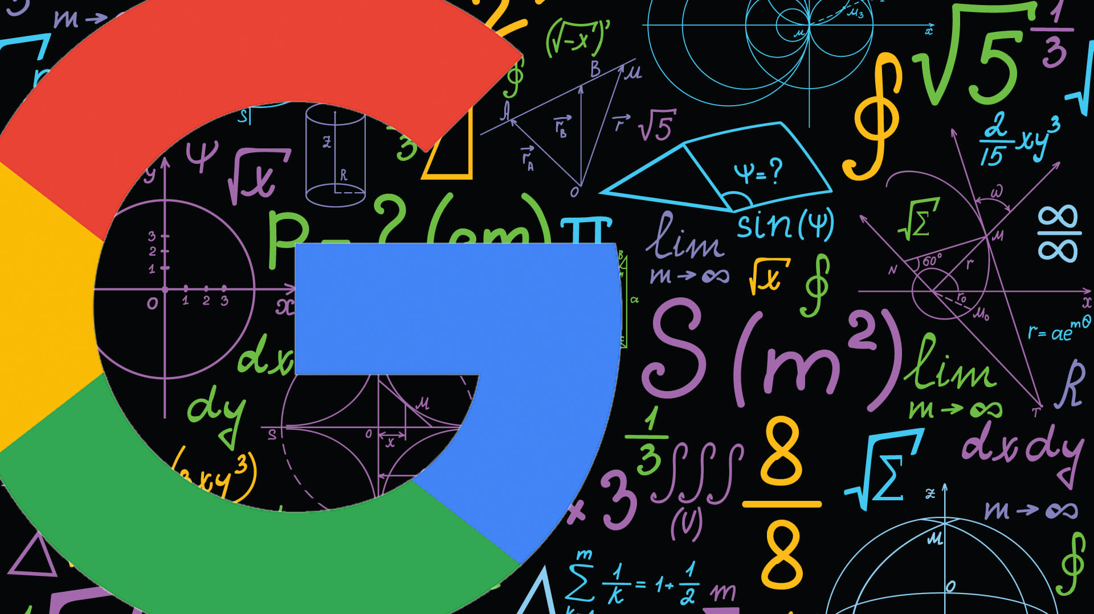
What is a Google algorithm?
  Google algorithm(s) is the way that Google selects and sorts the results for a given search query.
  Core algorithms
  Panda
  Penguin
  Page rank
  Algorithm Changes
  Medic (August 1st 2018)
  Fred (March 2017)

Slide 10

Specific vs. broad algorithm change
  A single component of Google ranking algorithm
  Google Penguin 1.1: March, 2012
  Google Penguin 1.2: October, 2012
  Google Penguin 4.0: September, 2016
  A non-specific change that makes a huge impact
  Medic algorithm update
  Florida 2.0 algorithm update

Slide 11

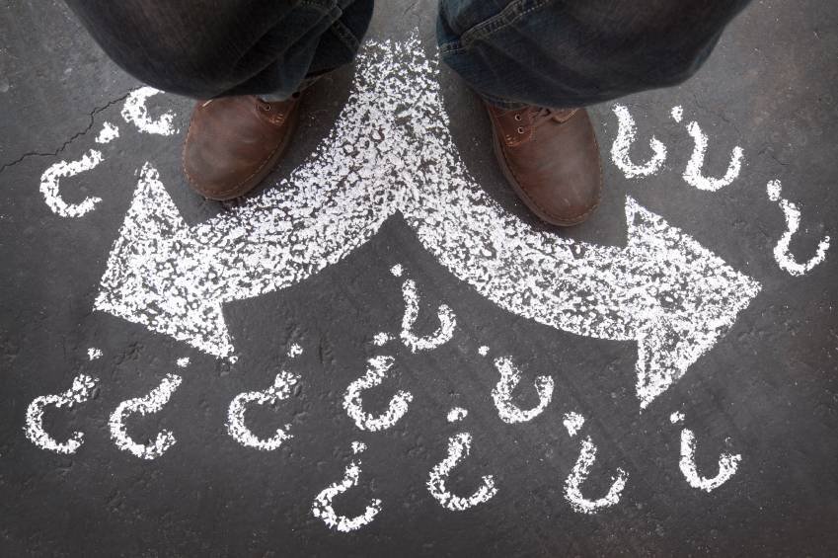
How to discover a Google algo. Update?
  Right ways
  Community chatters like Twitter.
  Ranking changes
  Google official announcements
  Authoritative sources (SEL, SEJ, SEW, … )
  Community or super-authoritative based
  Not always right ways
  Rumors
  Ranking changes (A few queries and websites )
  Non-community based

Slide 12

How to prevent rank loss by algo. update?
  Keep your hat as white as possible
  Do according to the guidelines
  Do NOT invent tricky dangerous things.

Slide 13

And sometimes it happens…

Slide 14
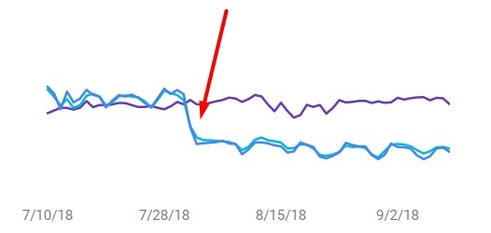
Organic traffic drop: algo. change
  Occurs before, during and/or after an algorithm change.
  How to figure it out?
  Signs
  Not trendy
  Clicks are dropped
  Impressions are dropped
  Avg. position of most of keywords remains the same.

Slide 15
Possible scenarios
  Total impressions
  Avg. position
  Total clicks
Tricky question

Slide 16
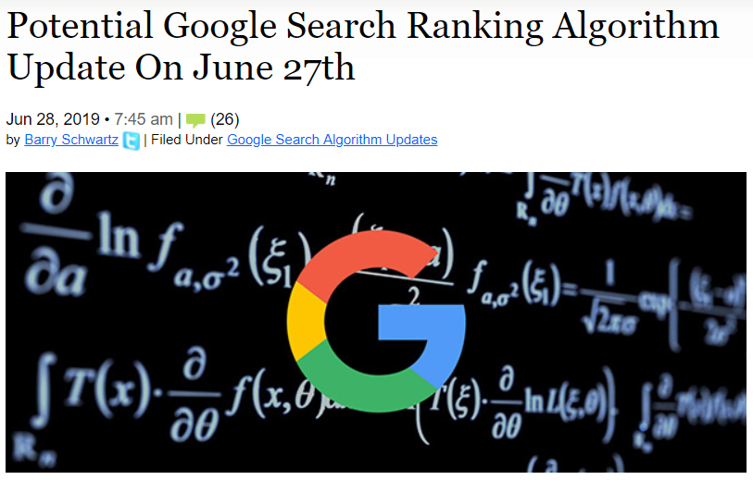
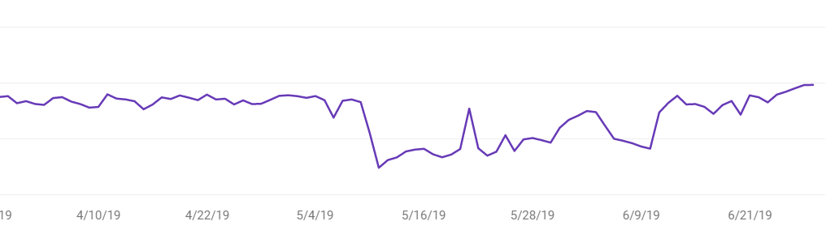
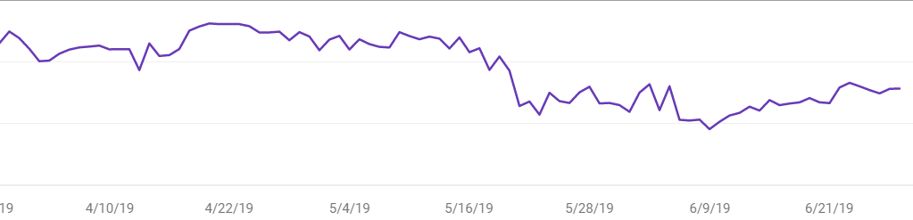
How to deal with it?
  Relax and take a couple of days off!
  Wait for a while until everything is stable. There are rolling out and tweaking fixes.

Slide 17
  Stay up-to-date with the authoritative sources and chatters.
  Keep spying on the competitors.
  Try, find issues/opportunities to fix/improve them, move on.

Slide 18
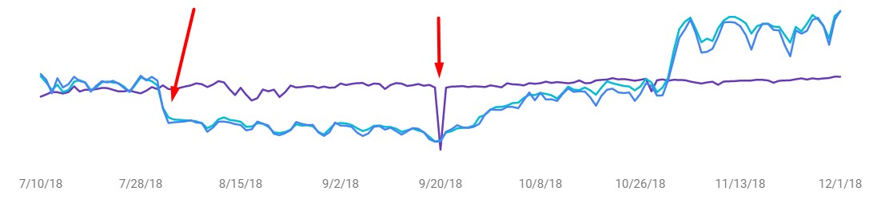
  Keep up the good work
  Note that it may take quite a while until it gets fixed.
28-7-2018
20-9-2018
01-11-2018
54 days
42 days
Tricky question

Slide 19
Some of possible traffic drop reasons
  Trendy drop/leap
  Algorithm change
  Google penalty/sandbox
  ?

Slide 20
What is a Google penalty?
  A Google penalty is the negative impact on a website’s search ranking based on Google algorithms or manual review.
  Penalty levels
  Keyword level
  Page level
  Hostname level
  Site-wide
  De-indexing

Slide 21

How to discover traffic drop due to Google penalty
  Not trendy
  Not caused by algorithm update
  Not sandbox
  Same pattern as Google algorithm update
  For specific kws. / pages / …
  It is only you losing rankings

Slide 22

How to deal with it?
  STAY CALM! Remember even biggest websites have been penalized.
  Check the Google search console (GSC ) manual actions section.

Slide 23
  Understand the penalty level.
  Review the actions you did on the website.
  Take a look at link profile.

Slide 24
How NOT to deal with it?
  Give up the domain unless it is banned
  Buy more links to cover up
  Add more text to your pages

Slide 25

Things that most probably WON’T cause a Google penalty
  Useful internal or inbound links
  Text content
  Old lost links

Slide 26

Things that may cause a Google penalty
  Massive link building
  Fake imperssions

Slide 27
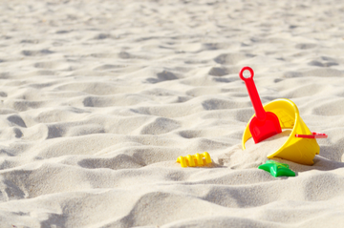
What is Google Sandbox effect?
  Links will be devalued (Not as effective )
  Active age of domain (In certain field )
  Competitive keywords
  How to prevent?
  No way!
  How to lift?
  Keep up the good work and prove that
  you are the best

Slide 28
Some of possible traffic drop reasons
  Trendy drop/leap
  Algorithm change
  Google penalty/sandbox
  Google tests/Temporary fluctuations

Slide 29
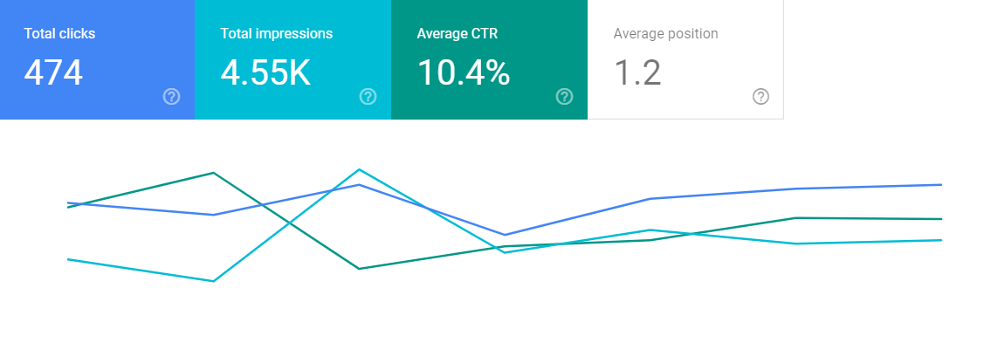
Bonus tip: Fake impressions
  What they are?
  2 ways to check: CTR and source check
  Consequences
  Do we need to worry about them?
  How to deal with them?

Slide 30
Summary
1
  Trendy drop/leap
  Algorithm change
  Google penalty/sandbox
  Google tests/Temporary fluctuations
4
3
Require time
2

Slide 31

Keep in mind
  Google needs best experience for searchers.
  Google tests, prevent zero-time ranking manipulations.
  Google algorithms help us to rank better if we are better.
  Google penalty/sandbox helps us to stay ahead of the evils.

Slide 32



Thank you
  Proudly presented to you by Shayan Davoodi
shayan-davoodi@outlook.com
https://www.linkedin.com/in/shayan-davoodi
live:shayan-davoodi
Special thanks to: Websima academy , Amin Esmaeili , Keyvan Barikani , Shahin Nesahat
Sources: seroundtable.com , Google webmaster central , Webmasters office-hours hangouts by John Mueller, Wikipedia.org, Ahrefs blog, Search engine watch

